Slide 1
The Worm and the Book
Making and Sustaining Digital Archives

Slide 2
Overview
Old English Riddles (Exeter Book 47)
Making Digital Archives
Using & Sustaining Digital Archives
Resurrections

Slide 3
Moððe word fræt. Me þæt þuhte wrætlicu wyrd, þa ic þæt wundor gefrægn, þæt se wyrm forswealg wera gied sumes, þeof in þystro, þrymfæstne cwide ond þæs strangan staþol. Stælgiest ne wæs wihte þy gleawra, þe he þam wordum swealg.
A moth ate words. That seemed to me a marvellous happening, when I heard about that wonder, that the worm swallowed up a certain man’s song, the thief in darkness, a glory-fast speech and its strong foundation. The stealing guest was not at all the wiser, for those words he swallowed.
Notes:
I want to begin with a riddle. It’s from the Old English Exeter Book, a tenth-century manuscript that contains Old English poetry and prose—and includes a collection of riddle poems, like this one. The most frequent solution is Moth or Bookworm: a creature that devours books and so swallows up human knowledge and its “strong foundation” without understanding.

Slide 4
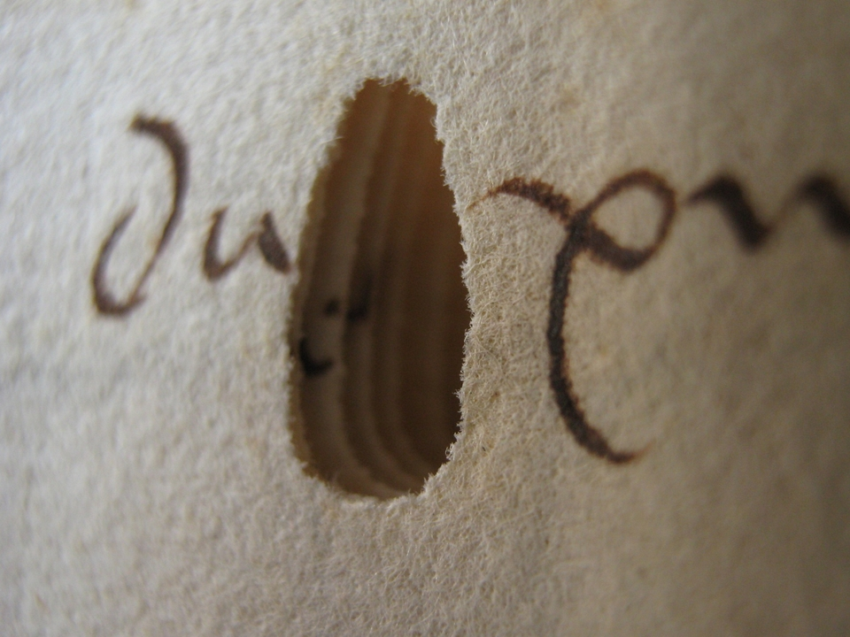
Bookworm Damage
Eric Kwakkel, “Killer bookworm holes”; Image: 15th-century manuscript in Dubrovnik archives, photographed by Emir O Filipovic (@EmirOFilipovic).
Notes:
Here’s an example of bookworm damage in a manuscript. Eric Kwakkel writes: “The most peculiar thing about the holes [bookworms] left behind is that they usually stop halfway the book. It is as if the worm, finished with his meal, turned around and traced his steps back to the restaurant’s exit. Like a satisfied customer.”

Slide 5
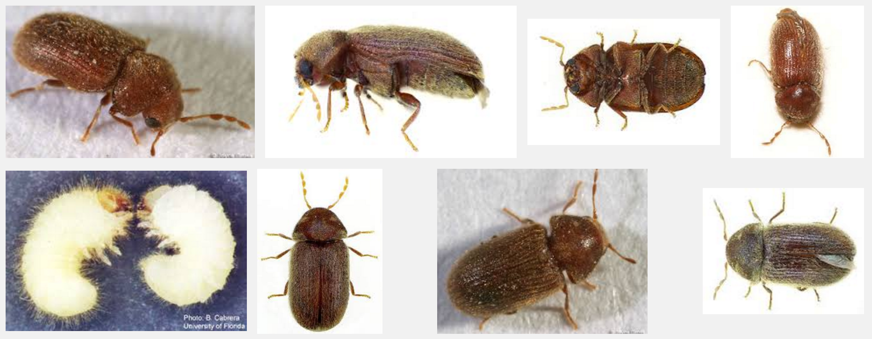
Notes:
Bookworms: Insect images

Slide 6
Moððe word fræt. Me þæt þuhte wrætlicu wyrd, þa ic þæt wundor gefrægn, þæt se wyrm forswealg wera gied sumes, þeof in þystro, þrymfæstne cwide ond þæs strangan staþol. Stælgiest ne wæs wihte þy gleawra, þe he þam wordum swealg.
A moth ate words. That seemed to me a marvellous happening, when I heard about that wonder, that the worm swallowed up a certain man’s song, the thief in darkness, a glory-fast speech and its strong foundation. The stealing guest was not at all the wiser, for those words he swallowed.
Notes:
I want to begin with a riddle. It’s from the Old English Exeter Book, a tenth-century manuscript that contains Old English poetry and prose—and includes a collection of riddle poems, like this one. The most frequent solution is Moth or Bookworm: a creature that devours books and so swallows up human knowledge and its “strong foundation” without understanding.

Slide 8
Traditional Associations
“wyrd” (fate) -- splendid buildings in ruins; the death of kings, warriors, civilization; the destructiveness of time
“wyrm” (worm) -- dragon

Slide 9
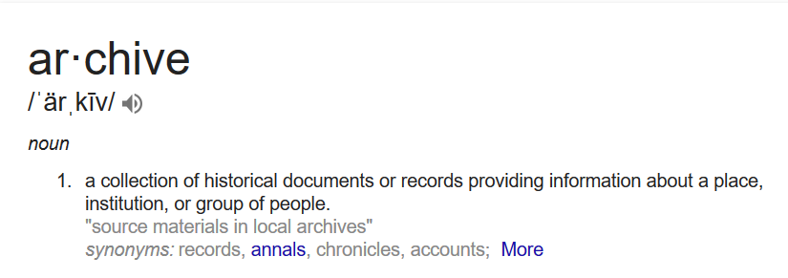
Notes:
An archive is a collection of historical documents or records providing information about a place, an institution, or a group of people.

Slide 10
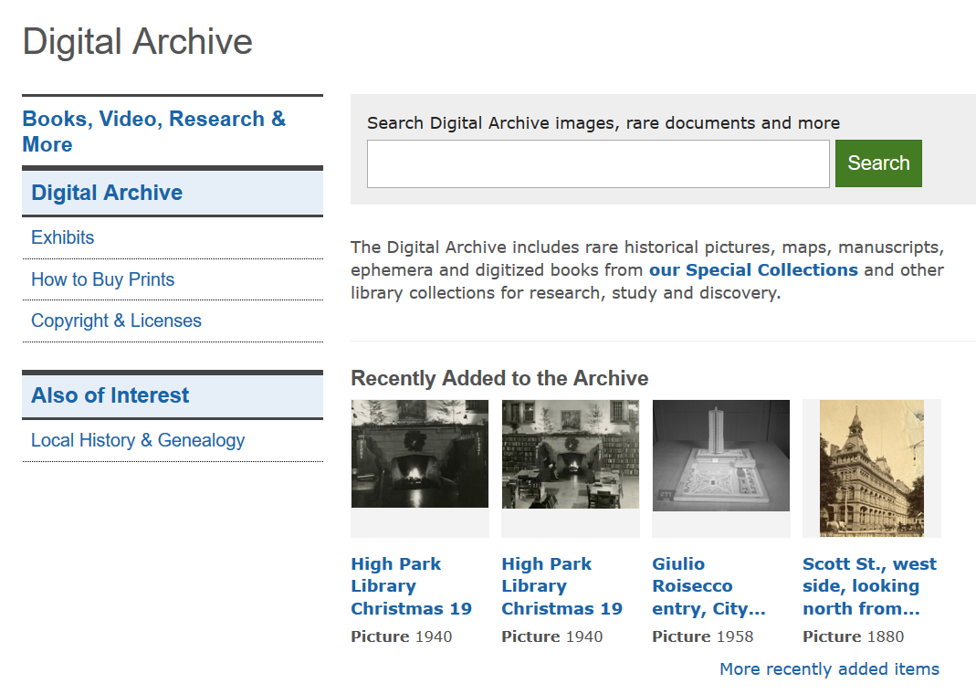
Toronto Public Library Digital Archive: Print Media, Digitized
Notes:
Digital archives can originate with print media, like the Toronto Public Library Digital Archive.

Slide 11
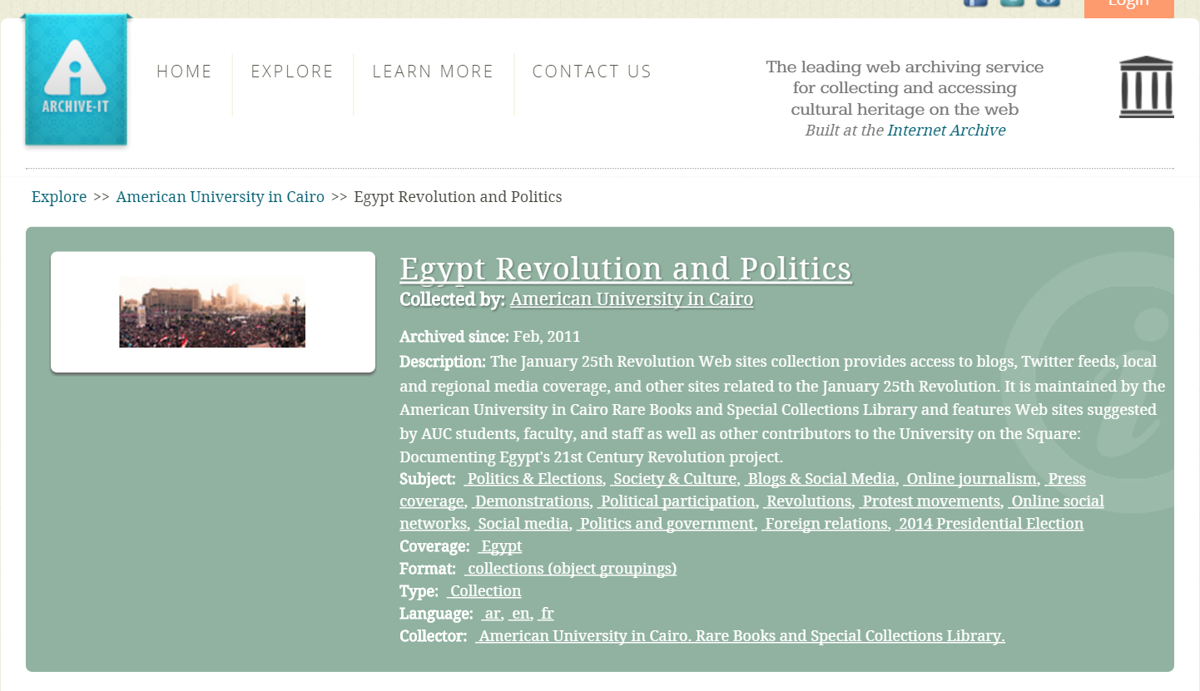
Digital Archives: Egyptian Revolution (Born Digital)
https://archive-it.org/collections/2358
http://guides.library.cornell.edu/c.php?g=31688&p=200748
https://storify.com/acarvin/new-story-2
Notes:
Other archives are born digital. Here is an archive of social media activity during the Egyptian revolution of 2011: tweets, blogs, Facebook posts, and so on. This is maintained by the American University in Cairo in partnership with the Internet Archive.

Slide 12
Digitized Manuscripts (British Library)
Sounds
(British Library)
Legal Documents (The National Archives, Public Record Office, Kew, UK)
Oral Histories (National Archives of Singapore)
Books (British Library)
Video Footage (Getty Images)
Social Media
Newspapers (Google Digitization)
Notes:
Archives consist of records: digitized manuscripts, books, newspapers, legal documents, video footage, oral histories, sounds, tweets.

Slide 13
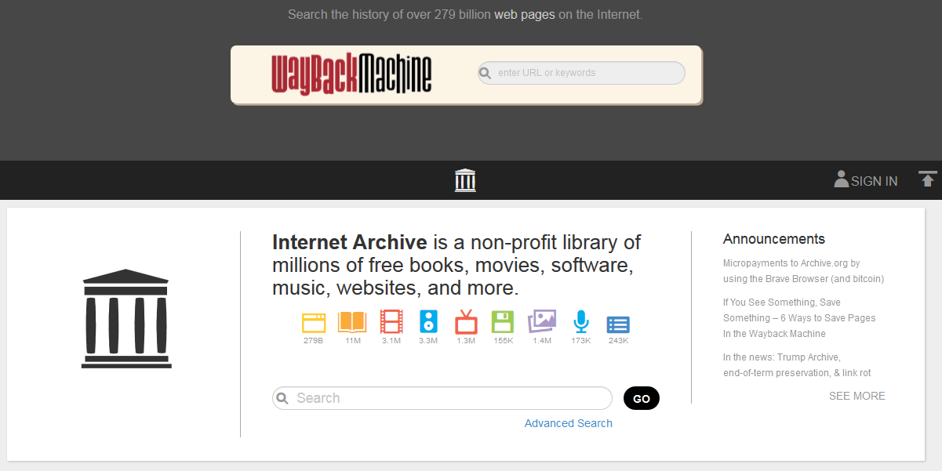

Slide 14
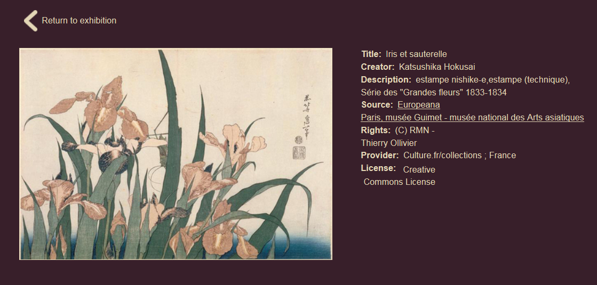
Metadata
Metadata: structured data about data
Standard metadata schemas include Dublin Core, MARC, and MODS (each of these schemas has a different set of information it collects).
Europeana Art Nouveau Exhibition. Individual record: Hokusai, Iris et sauterelle.
Individual item metadata includes title, creator, description, source, rights, etc: the elements of the Dublin Core metadata schema.
Notes:
Each record of an archive is described by metadata: structured data about data. For example, think about your library’s online catalogue: it contains the records of books, with fields like Author, Title, Publisher, Editor, Date. Or take a look at the catalogue entry for this print: its metadata includes title, creator, description, source, rights, etc: the elements of the Dublin Core metadata schema. A metadata schema is a set of categories you choose to describe: a set of headings, if you will. If you use standard metadata schemas, like Dublin Core, MARC, or MODS, your data will be discoverable and interoperable with library catalogues or other data sets.

Slide 15
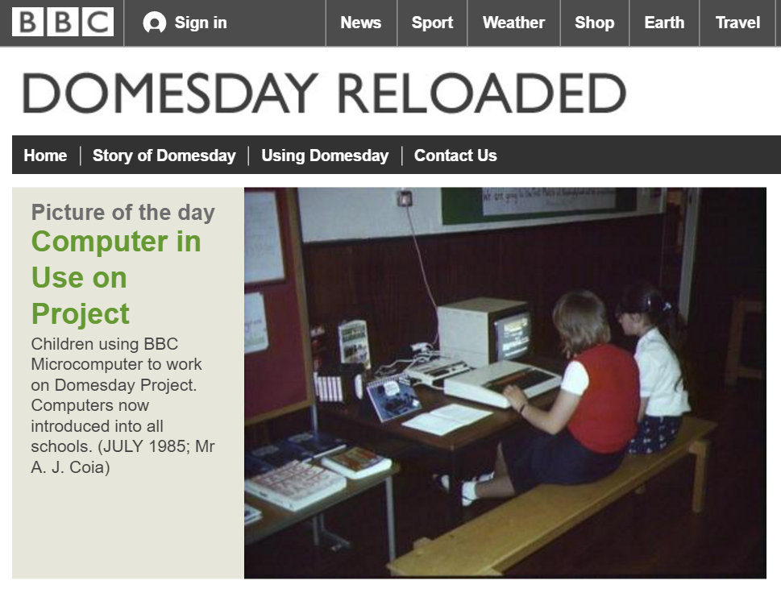
Notes:
The DOMESDAY project was lost--until, roughly, 2011. After efforts by academics and technologists around the world, the BBC’s own technologists, George Auckland and his Innovations Team, completed the extraction of the laser disc. The BBC Domesday Book is now available to the world at large online.
The story is a convenient parable of the fragility of digital archives. This one was resurrected because of significant public interest; a lesser archive would have slept in the graveyard of its outdated infrastructure. Just as books are vulnerable to fires, floods, wars, worms, too much or too little interest—so digital archives are vulnerable to file degradation and server failures; changes in data standards; changes in software or hardware; even to changes in interface fashions.

Slide 16
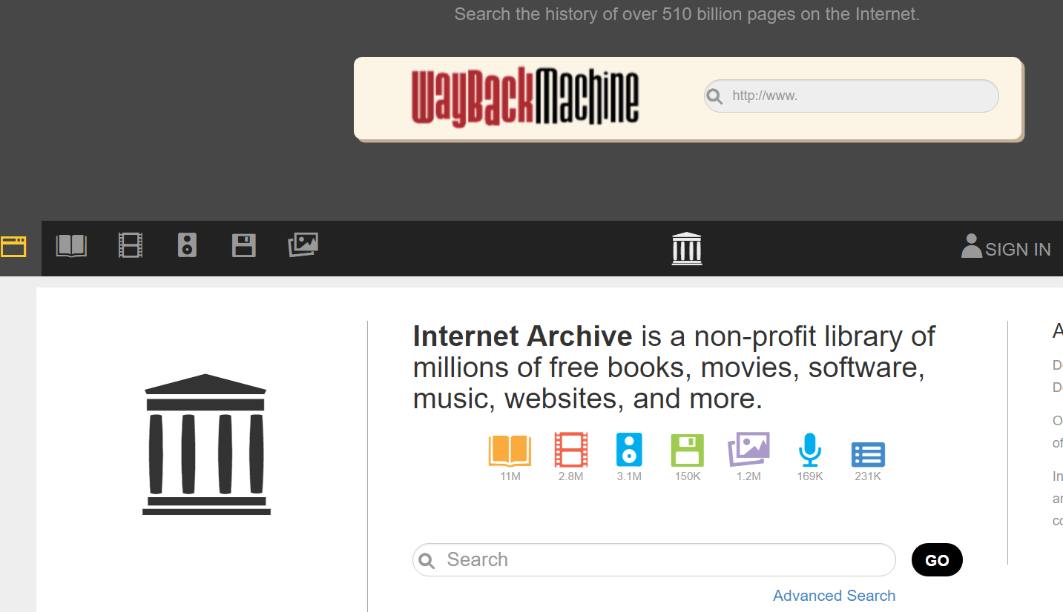
Notes:
How are digital archives created? For my first example—the digitization of physical collections--I want to draw on work at the Internet Archive—work I had the privilege of witnessing thanks to Andrea Mills, at the Internet Archive scanning centre here in Robarts Library. The Internet Archive, a San Francisco–based nonprofit digital library whose stated mission is "universal access to all knowledge". The Internet Archive provides free public access to collections of digitized materials, including books, movies, software, music, and websites. On the 7th floor of Robarts, the Internet Archive digitizes books—from Fisher Rare Books Library; from other UofT libraries; and from all over Canada. In the slides that follow, I want to trace the journey of these materials from physical artifact to digital surrogate.

Slide 17
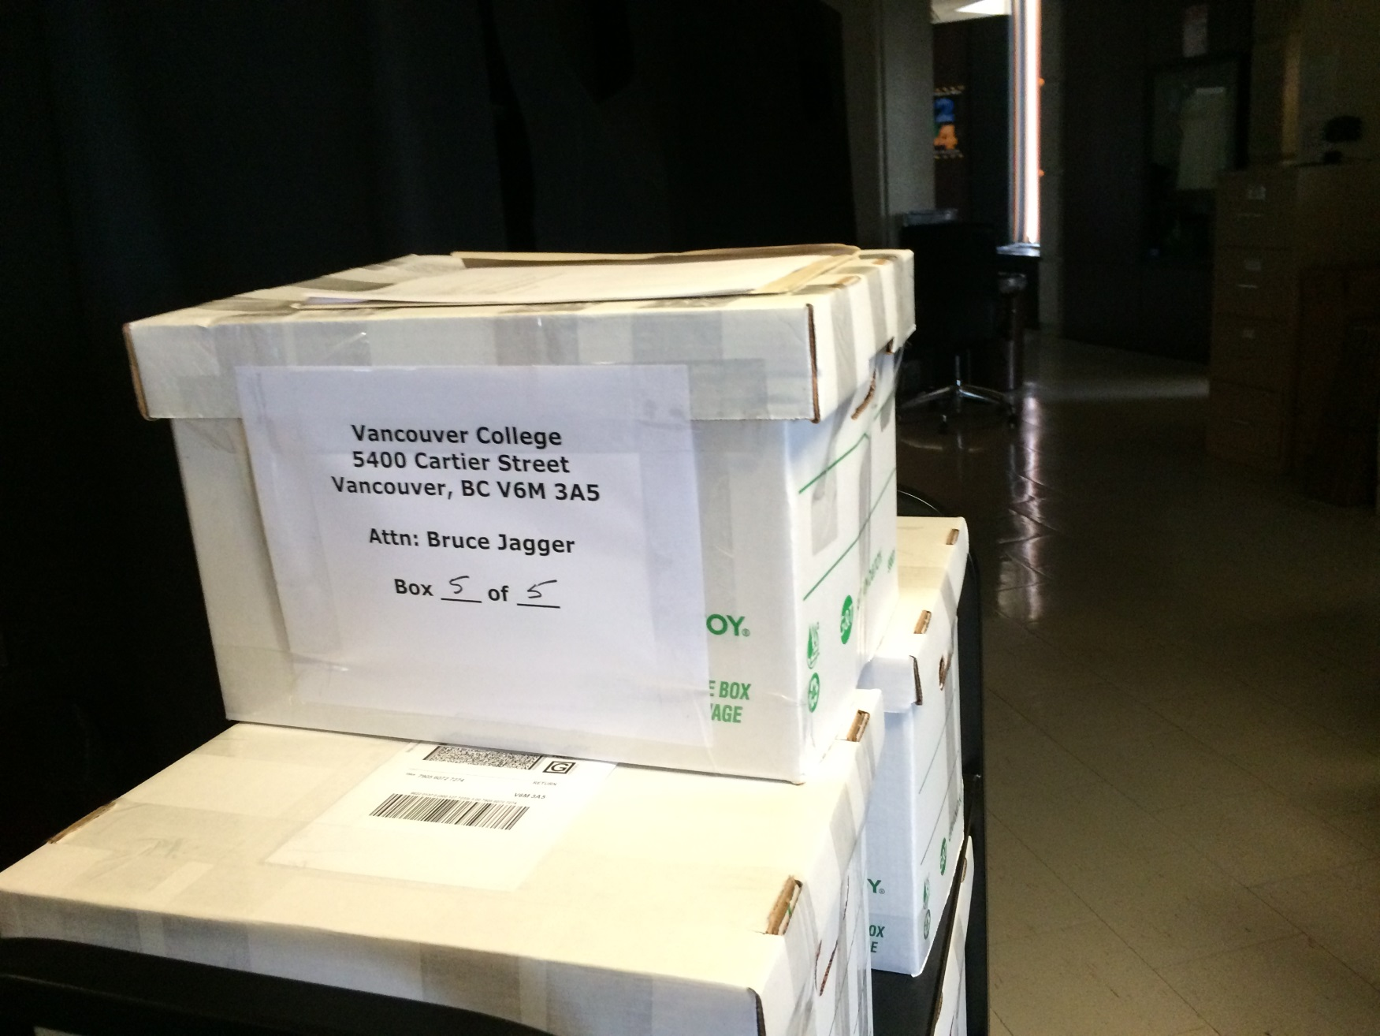
Internet Archive: Materials for digitization. Photo: A. Bolintineanu, 2016.
Notes:
Digitization requires very specialized equipment and expertise. Before digitization can begin, materials travel to the scanning centre. Some books travel in humble cardboard boxes, like this stack of yearbooks from Vancouver College.

Slide 18
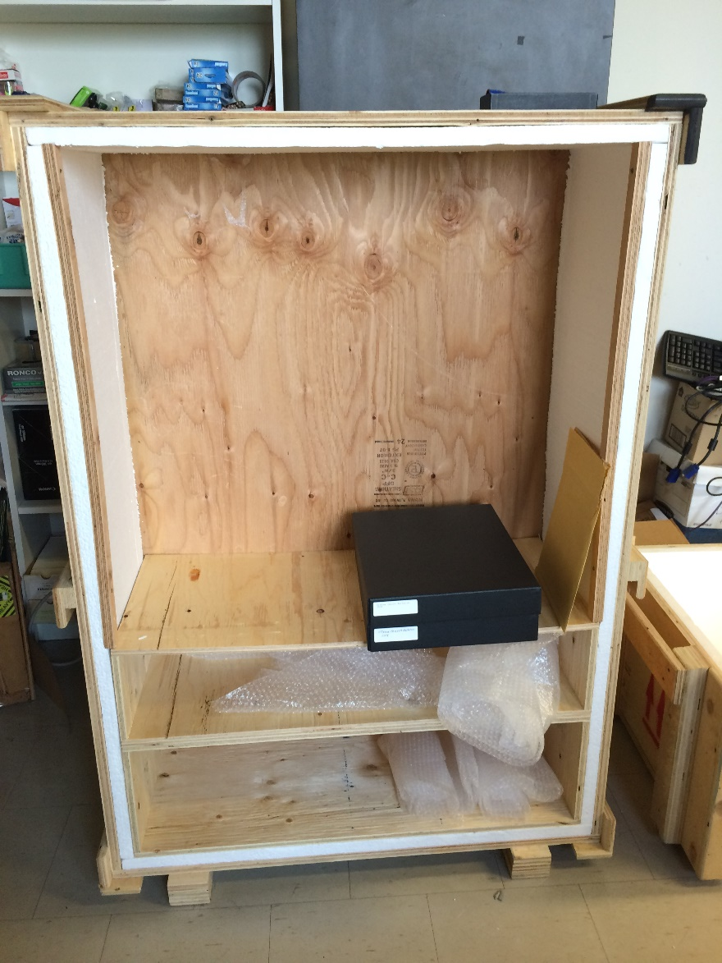
Internet Archive: Materials for digitization. Photo: A. Bolintineanu, 2016.
Notes:
Other materials travel in style—in this case, in enclosed archival boxes that themselves travel in padded wooden crates very much like vampire coffins (because, like vampires, these books are fragile and long-lived, travellers from an earlier time).

Slide 19
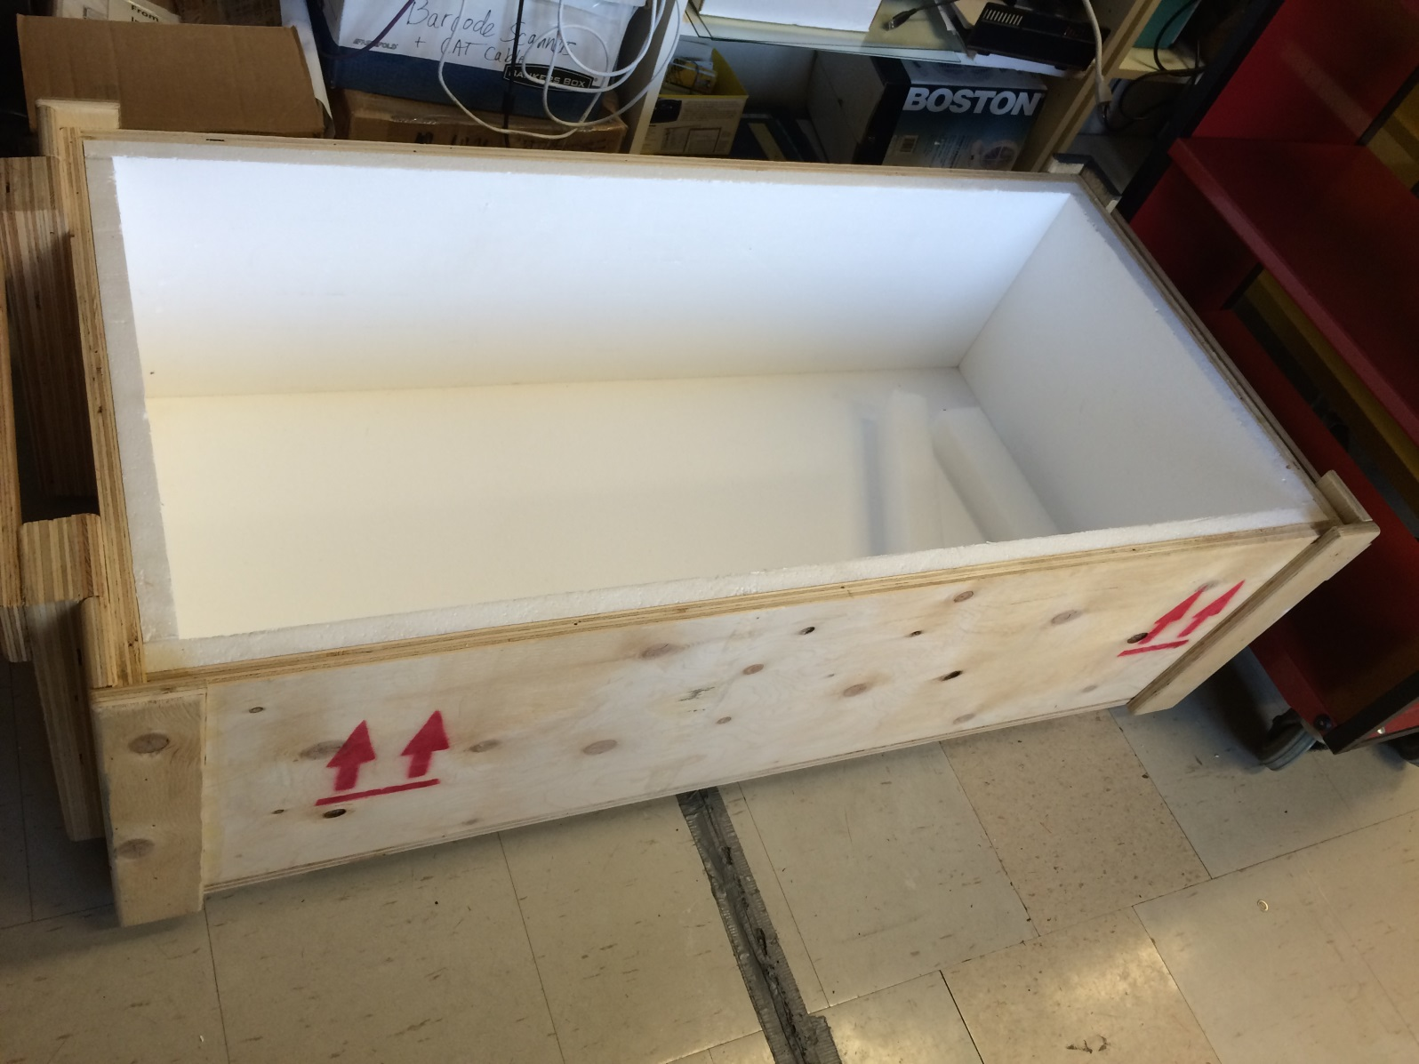
Internet Archive: Materials for digitization. Photo: A. Bolintineanu, 2016.
Notes:
Here’s the vampire coffin.

Slide 20
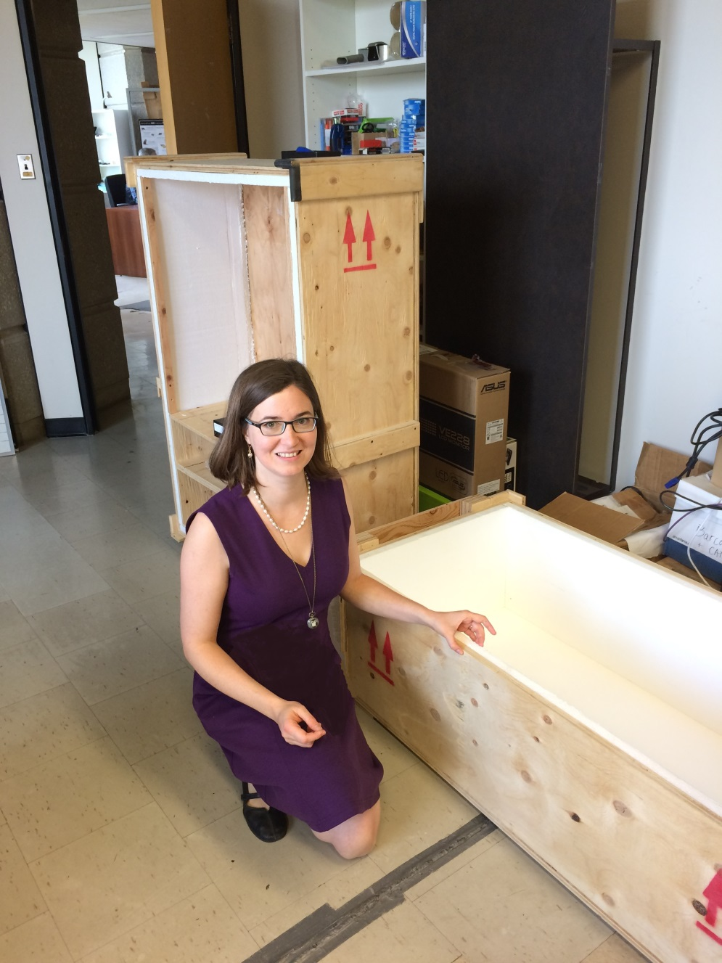
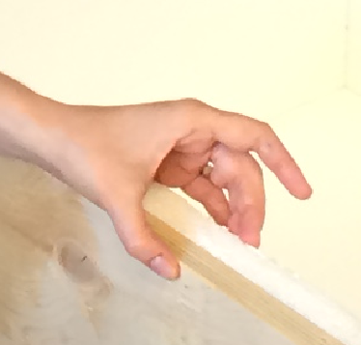
Internet Archive: Materials for digitization. Photo: A. Bolintineanu, 2016.
Notes:
Here is a human being, for scale. My disembodied hand indicates the thickness of the padding of the box in which the boxes of archival materials were stored.

Slide 21
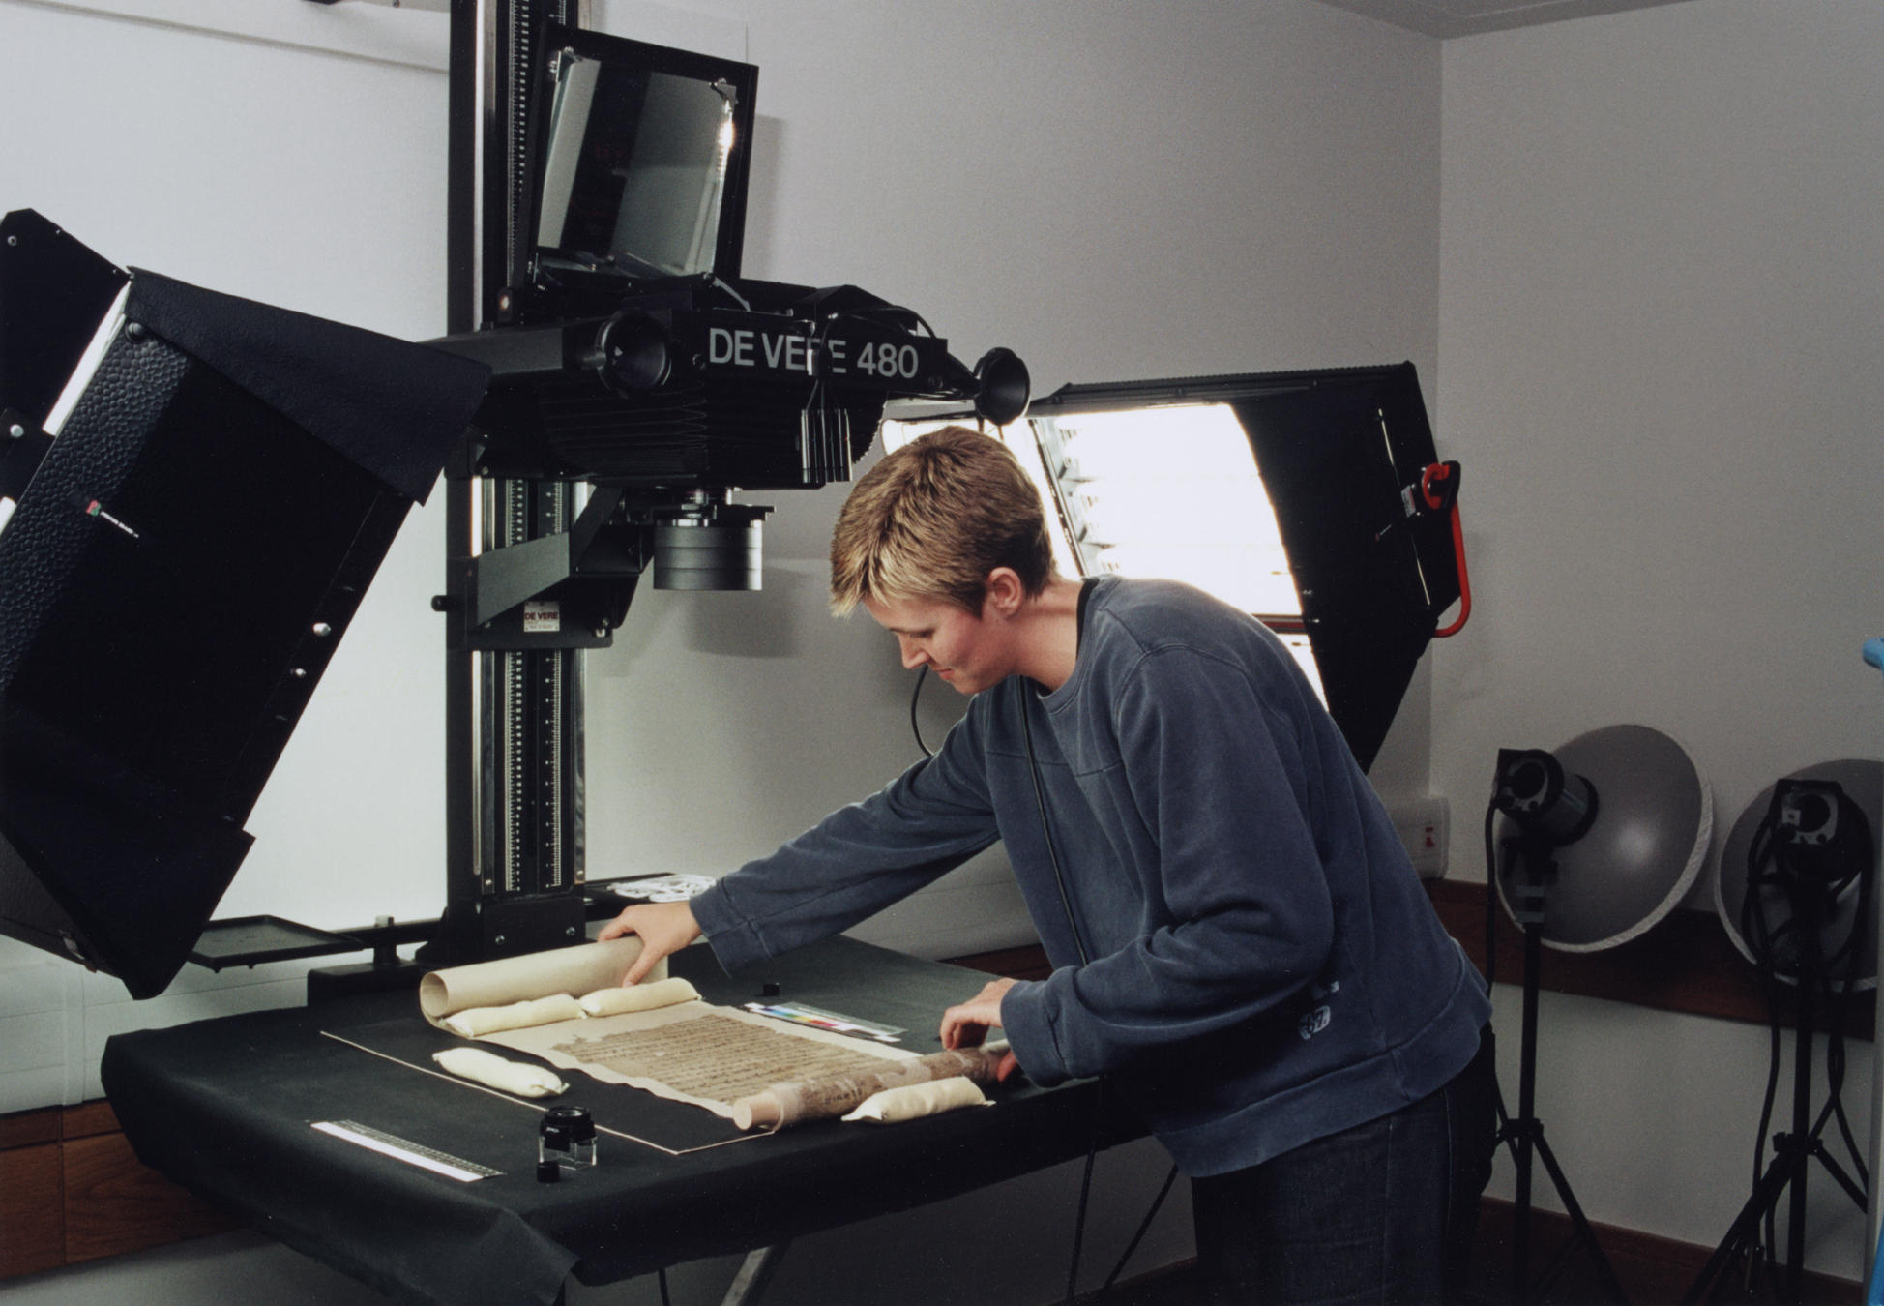
Digitizing Manuscripts
Digitisation of a Dunhuang manuscript (Pictured: De Vere 480 camera. Wikipedia: International Dunhuang Project, 2006.)
Notes:
Once you have assembled your material, digitization work can begin. You’ll need a specialized camera that can capture the colours of your manuscript, the tiny details (some not visible to the naked eye), erasures, scribal doodles, the marginal notes written by scribes and readers over the years, even bookworm damage. You’ll need a cradle to support the manuscript. You’ll need a conservation-friendly room, where you can control all the light sources, to make sure you take the clearest, most accurate photograph.

Slide 22
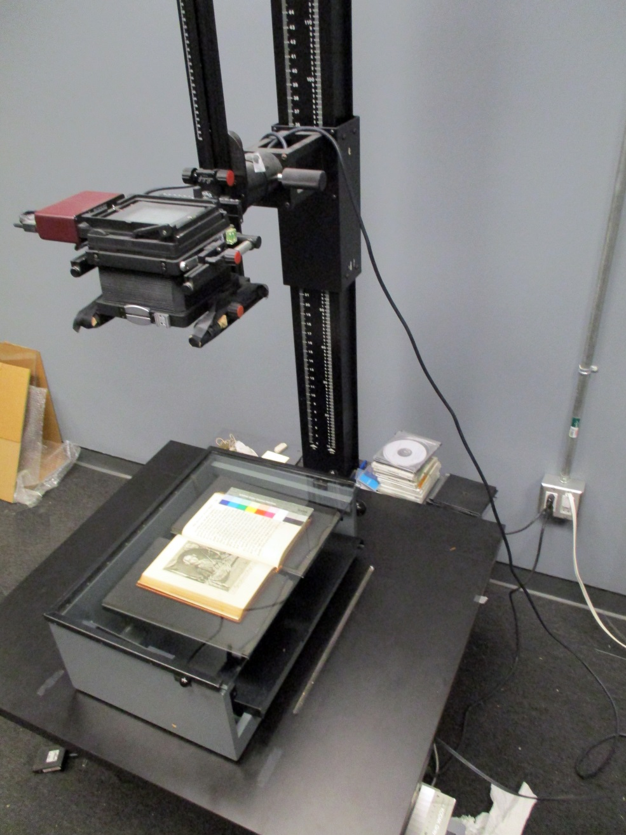
Digitizing Printed Books
Digitizing Books at the Fisher Library (Photo: Paul Armstrong, 2016)
Notes:
Here is a specialized scanner as used by the Fisher Library. Notice the black book cradle under the book, and colour calibration strip on the right-hand side of the book. These help ensure archival-quality images.

Slide 23
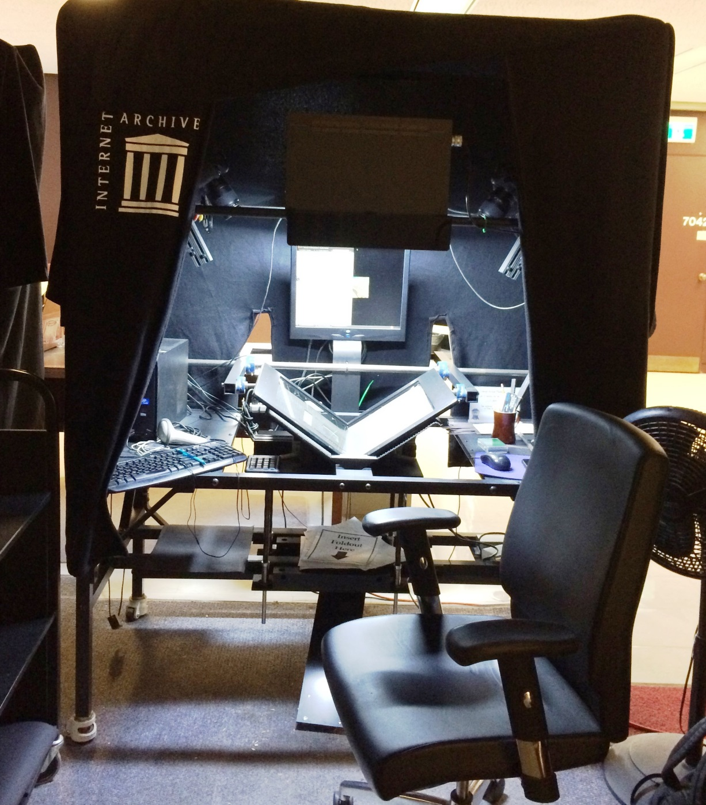
Digitizing Printed Books
Digitizing Books at the Internet Archive, University of Toronto (Photo: Alexandra Bolintineanu, 2016)
Notes:
Here is a specialized scanning station from the Internet Archive’s outpost on the seventh floor of Robarts. Notice the curtains around the station, ensuring a minimum of light interference; the bright light on the scanner itself; the computer screen, to check the quality of the scan; and the book cradle, holding the book half-open so as not to injure its spine. On the seventh floor of Robarts, in the Internet Archive’s quarters, there are seven or eight such digitization stations, each in its own cocoon of drapery and with its own overhead light.

Slide 24
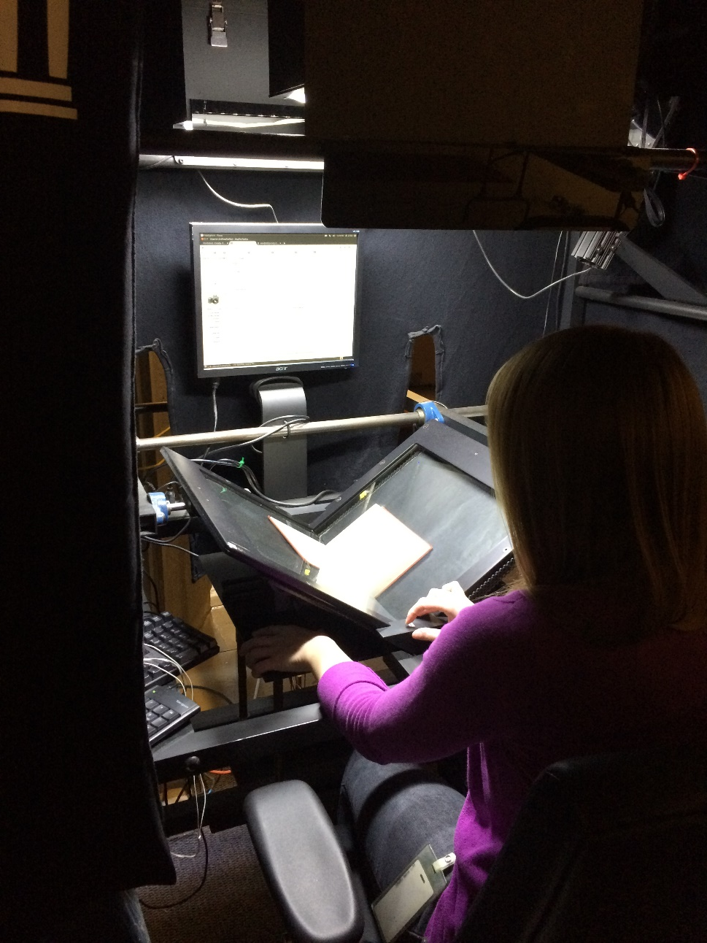
Digitizing Printed Books
Digitizing Books at the Internet Archive, University of Toronto (Photo: Alexandra Bolintineanu, 2016)
Notes:
The scanning bed is angled, forming a book cradle that allows a book to sit partially open. This supports fragile spines and bindings.

Slide 25
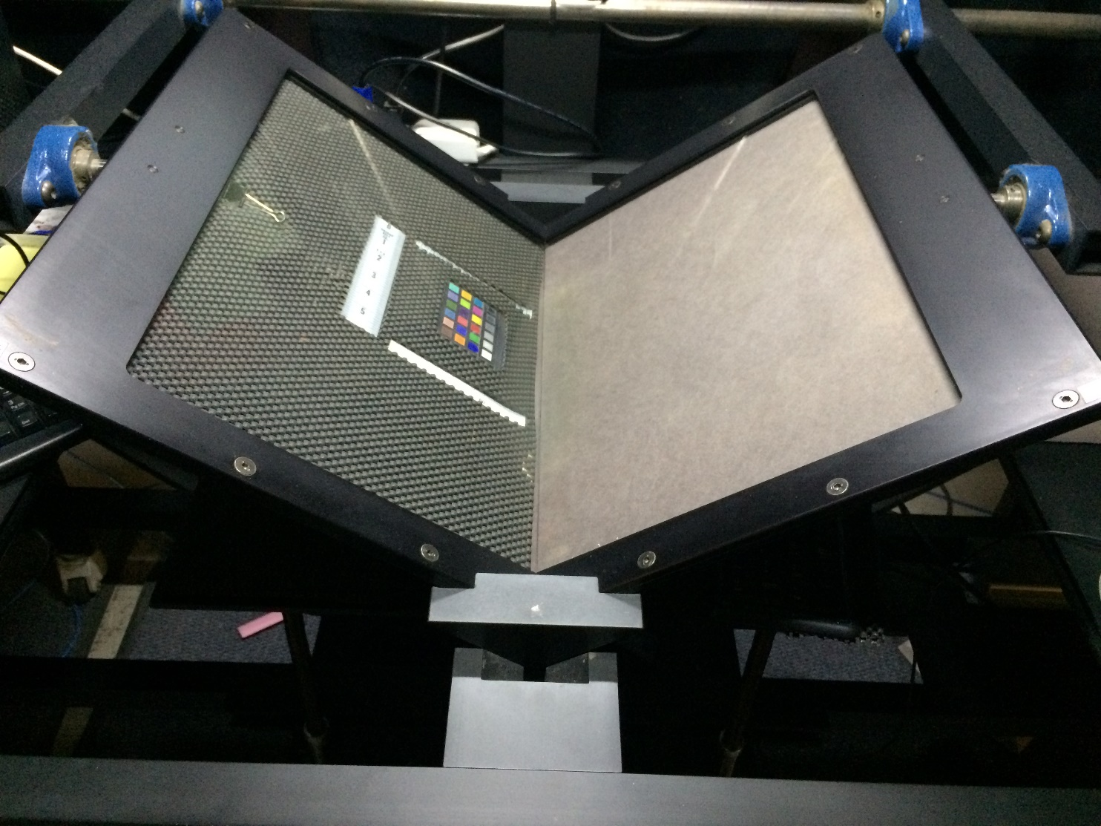
Digitizing Printed Books
Digitizing Books at the Internet Archive, University of Toronto (Photo: Alexandra Bolintineanu, 2016)
Notes:
Colour reference sheets help calibrate the scanner, ensuring the colours it records in its images are as accurate as possible.

Slide 26
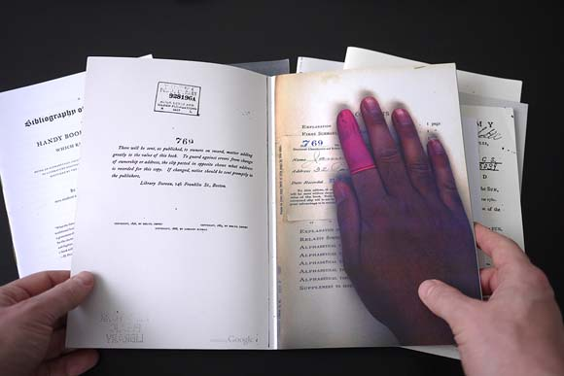
Digitization Errors
Image: “Special Collection” (2009), by Benjamin Shaykin. Photo by the Library of the Printed Web. Cited by Kenneth Goldsmith, “The Artful Accidents of Google Books,” The New Yorker (December 4, 2013).
Notes:
Not from the Internet Archive, but from Google Books, here is an example of digitization error: the hand of a scanner operator appear in digitized Google Books.

Slide 27
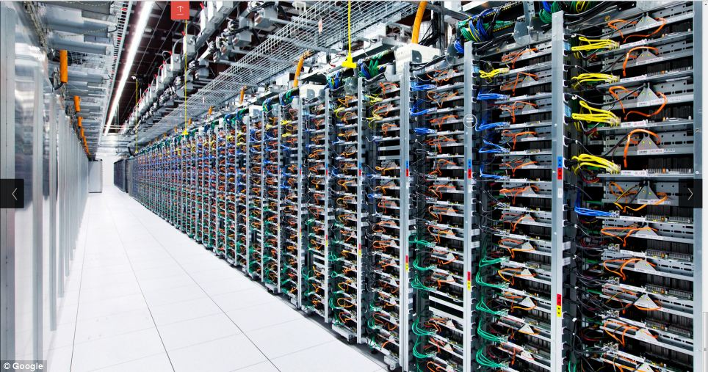
Google Data Centre: Server Farm
Image: Google, Data Centre Gallery (https://www.google.com/about/datacenters/gallery)

Slide 28
Banned Books Visit: Questions & Insights

Slide 29
“The Mirror of the World & Its Memory”

Slide 30
“Documentary heritage reflects the diversity of languages, peoples and cultures. It is the mirror of the world and its memory. But this memory is fragile. Every day, irreplaceable parts of this memory disappear for ever.”
UNESCO Memory of the World Programme,
quoted by the British Library, Endangered Archives Programme

Slide 31
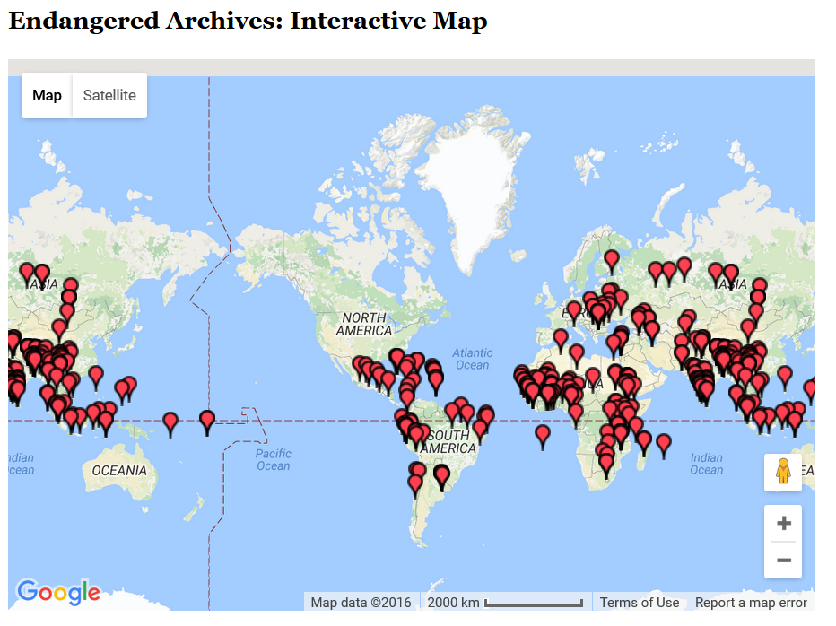
British Library, Endangered Archives Programme
http://eap.bl.uk/database/map.a4d

Slide 32
Resurrections

Slide 33
Hyperspectral or Multispectral Imaging

Slide 34
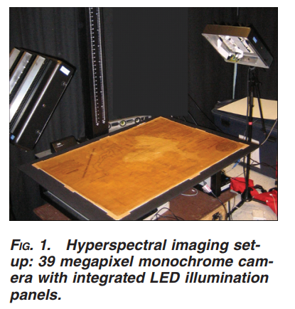
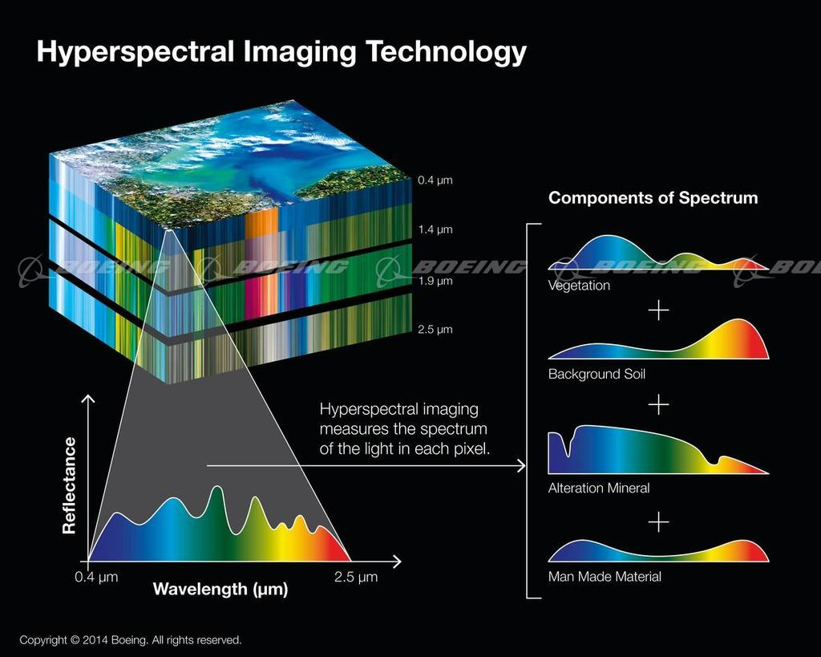
Hyperspectral or Multispectral Imaging

Slide 35
Hyperspectral or Multispectral Imaging
“a powerful, noncontact technique with a range of capabilities. The critical component of the advanced spectral imaging is the capability for chemical characterization of materials, providing both access and enhanced non-visible and visible information in registered highresolution digital images. This noncontact tool can identify and characterize colorants, inks, and substrates through their specific spectral response, monitor deterioration or changes due to exhibit and other environmental conditions, assess and potentially identify previous treatments that modify chemical and spectral responses of cultural heritage materials…” (Fenella G. France et al)

Slide 36
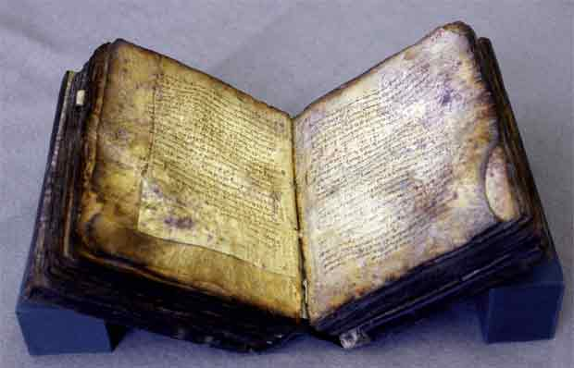
Archimedes Codex
https://www.ted.com/talks/william_noel_revealing_the_lost_codex_of_archimedes
http://archimedespalimpsest.net/Data/

Slide 37
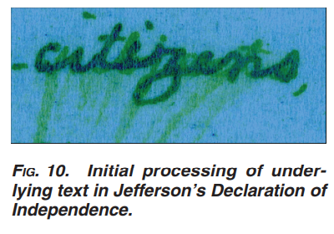
The Declaration of Independence (draft)

Slide 38
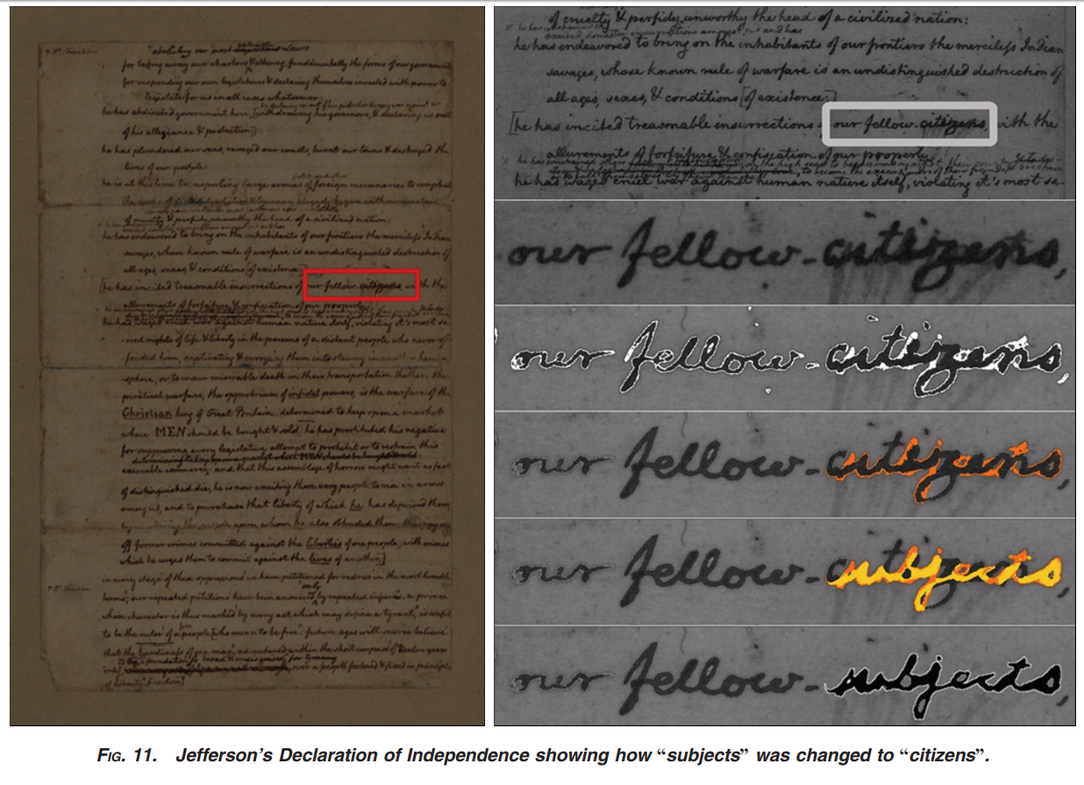

Slide 39
Risks to Digital Archives

Slide 40
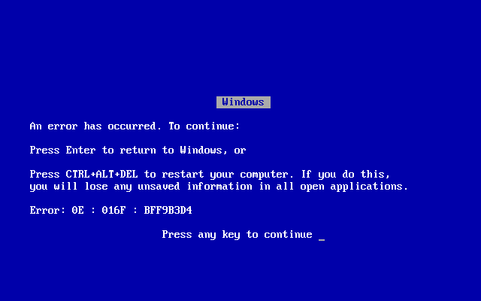
Risks to Digital Archives
Image: 15th-century manuscript in Dubrovnik archives, photographed by Emir O Filipovic (@EmirOFilipovic).
Image: Windows Blue Screen of Death (Wikipedia, original uploader: Akhristov at English Wikipedia. Public Domain.)
Notes:
Digital archives are not vulnerable to bookworms. But they are fragile – more fragile – in different ways. To illustrate this fragility, let’s consider the story of the two Doomsday Books.

Slide 41
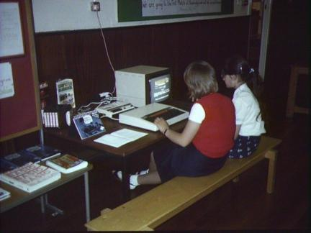
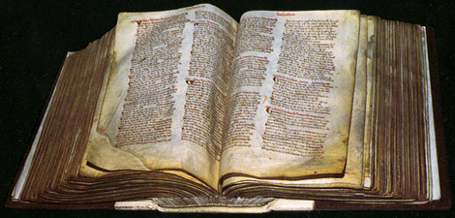
Doomsday Book
1086
1986
Notes:
Let me tell you the story of the two Doomsday Books. The firsts is a Latin manuscript of the eleventh century: for taxation purposes, William the Conqueror ordered a record made of landholders and their property in much of England and parts of Wales. The book was finished in 1086 and it resides at The National Archives at Kew, London.
The second Doomsday Book was a BBC initiative, 900 years later: an attempt to build a “digital snapshot of the country,” a documentation of everyday life in communities around the United Kingdom. Over a million people contributed.

Slide 42
The BBC Domesday Project was stored on adapted laser discs. Reading these discs required a state-of-the-art microcomputer, the Acorn BBC Master, customized with a specially produced laserdisc player.

Slide 43
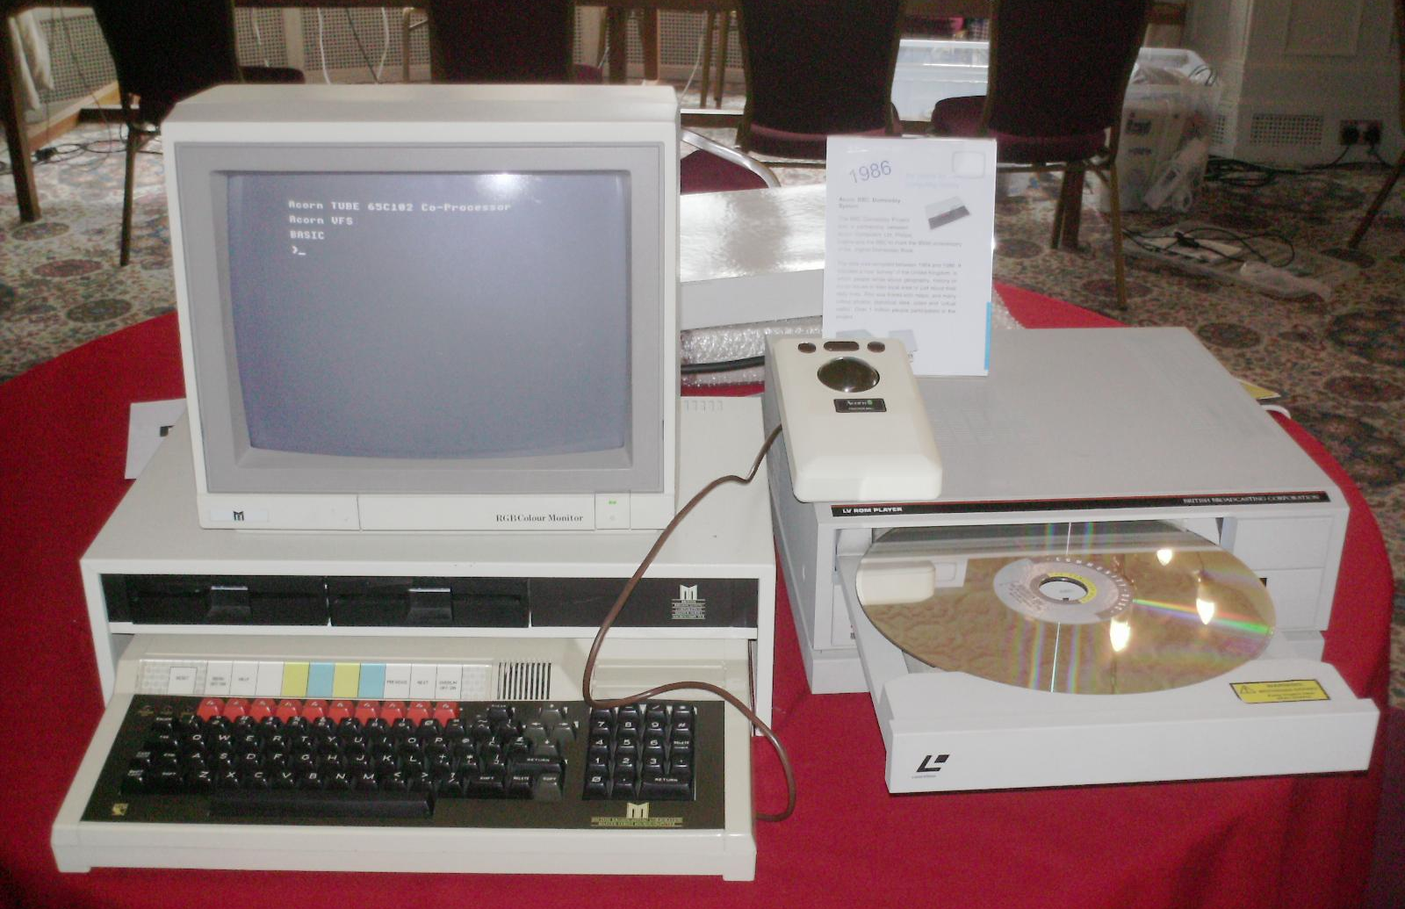
(Photo: A Domesday system at the Vintage Computer Festival 2010, Bletchley, UK. Photo by Regregex, Wikipedia.)
Notes:
Unfortunately, as the machines became obsolete, the laser discs and the data on them became unreadable. Until, roughly, 2011. After efforts by academics and technologists around the world, the BBC’s own technologists, George Auckland and his Innovations Team, completed the extraction of the laser disc. The BBC Domesday Book is now available to the world at large online.

Slide 44
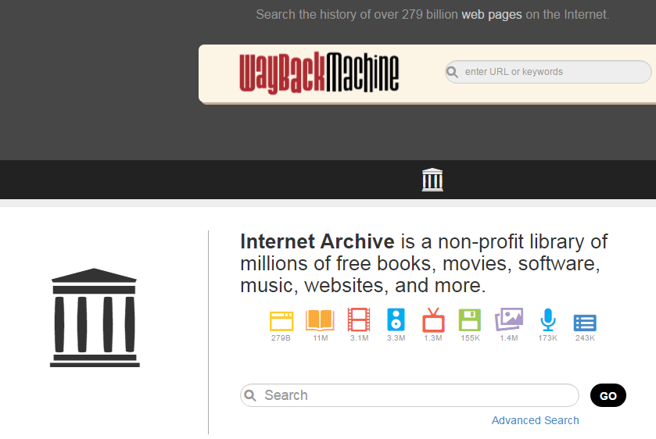
The Internet Archive: Political Data Destruction

Slide 45
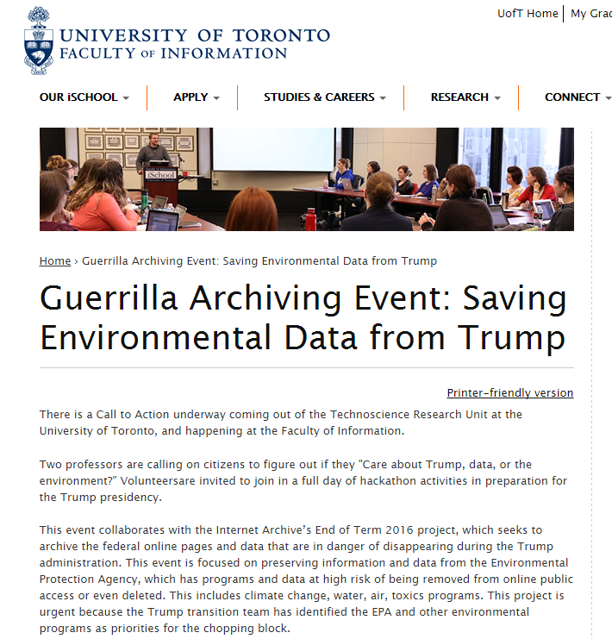
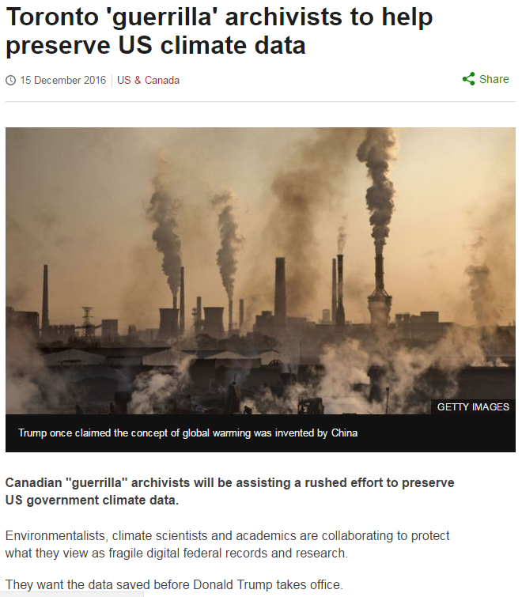
The Internet Archive: Public Engagement

Slide 46
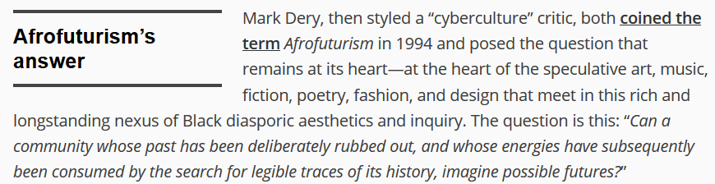
Marginalized Communities: Archival Absence

Slide 47
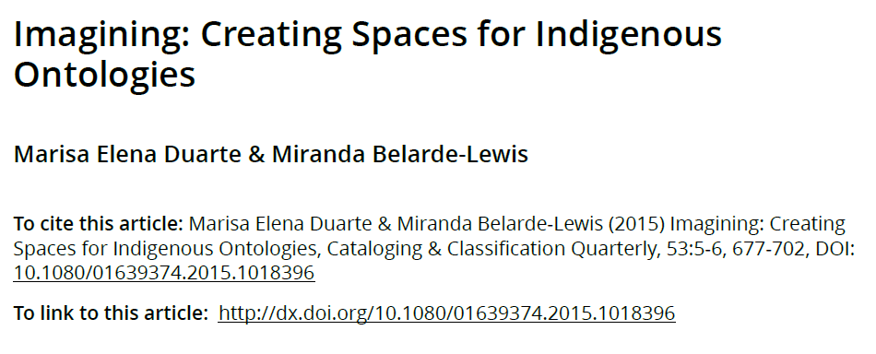
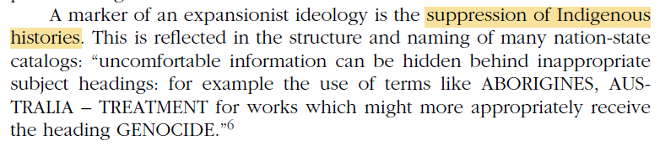
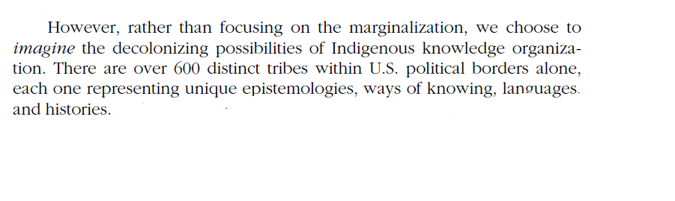
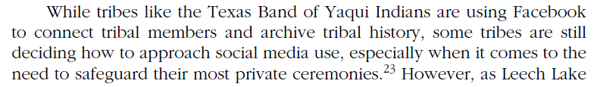
Marginalized Communities: Archival Misrepresentation

Slide 48
Marginalized Communities: Imagined Archives, Possible Communities
“We also need to enable the independent production, by our varied and often marginalized constituencies, of community-driven, future-oriented speculative collections. This means visions for change and social uplift that originate in archival material, yes, but also the introduction of novel ontologies and epistemologies for those libraries and archives: inventive assemblages, recovered cultural structures, and new knowledge representation. Can—for instance—digital knowledge infrastructures challenge Western, progressive notions of time as a forward-moving arrow and a regularly-ticking clock?” (Bethany Nowviskie, “5 spectra for speculative knowledge design”).

Slide 49
Death in the Archives: The Anthropocene
A wise man must recognize how ghastly it will be when all the wealth in this world stands waste—as even now throughout this middle-earth walls are standing, wind-blown, rime-covered, the ramparts storm-beaten. The wine-halls are crumbling, the rulers are lying dead, deprived of pleasure, the whole proud company has fallen near the wall […]. Thus the Creator of men laid waste this earthly abode until, bereft of the sounds of the citizens’ revelry, the ancient work of giants stood desolate. He who has wisely reflected upon this foundation, and deeply contemplates this dark life, wise at heart, often recalls a multitude of wars, and utters these words: “Where has the horse gone? Where has the man gone? Where has the giver of treasure gone? Where has the place of feasting gone? Where are the pleasures of the hall? Alas, the gleaming cup; alas, the armoured warrior; alas, the prince’s majesty! Truly, that time has passed away, has grown dark under the helm of night, as though it had never been. Now there stands, among the traces of that dear company, a wondrously high wall, decorated with serpentine patterns. The might of ash spears has snatched away the men, the weapon eager for slaughter, mighty fate. And storms beat on the heaps of stones, a falling snowstorm fetters the earth, winter’s lament; then darkness comes, the shadow of night, sends from the north fierce hailstorms to the terror of men. The whole kingdom of earth is full of sorrow; fate turns the world under the heavens. Here wealth is fleeting; here a friend is fleeting; here man is fleeting; here kinsmen are fleeting; all this foundation of earth grows desolate.” (The Wanderer, transl. S.A.J. Bradley, with my silent emendations)

Slide 50
Death in the Archives: The Anthropocene
[I]n Beowulf … we may see man at war with the hostile world, and his inevitable overthrow in Time… we may still, against his great scene, hung with tapestries woven of ancient tales of ruin, see the hæleð [warriors] walk… as in a little circle of light about their halls, men with courage as their stay went forward to that battle with the hostile world and the offspring of the dark which ends for all, even the kings and champions, in defeat… As the poet looks back into the past, surveying the history of kings and warriors in the old traditions, he sees that all glory (or as we might say 'culture' or 'civilization') ends in night. […] [W]e may remember that the poet of Beowulf saw clearly: the wages of heroism is death.
-- J.R.R. Tolkien, The Monsters and the Critics

Slide 51
Death in the Archives: The Anthropocene
“The problem is that of extinction—of multiple extinctions; heart-breaking extinctions; boring, quotidian, barely-noticed extinctions—both the absences that echo through centuries, and the disposable erosions of our lossy everyday. We edit to guess at a poet’s papers, long since burned in the hearth. We scrape through stratigraphic layers of earth to uncover ways of life forgotten, and piece together potsherds to make our theories about them hold water. Some of us model how languages change over time, and train ourselves to read the hands that won’t be written, anymore. Others promulgate standards to ward against isolation and loss. With great labor and attention, we migrate complex systems forward. […] And even while we delight in building the shiny and the new—and come to meetings like this to celebrate and share and advance that work—we know that someone, sooner or later, curates bits against our ruins.” (Nowviskie, “Digital Humanities in the Anthropocene”)

